Slide 1
Minimum Spanning Trees
What is the lowest weight set of edges that connects all vertices of an undirected graph with positive weights
Input: An undirected, positive weight graph, G=(V,E)
Output: A tree T=(V,E’) where E’ ⊆ E that minimizes

Slide 2
Definition of MST
Let G=(V,E) be a connected, undirected graph.
For each edge (u,v) in E, we have a weight w(u,v) specifying the cost (length of edge) to connect u and v.
We wish to find a (acyclic) subset T of E that connects all of the vertices in V and whose total weight is minimized.
Since the total weight is minimized, the subset T must be acyclic (no circuit).
Thus, T is a tree. We call it a spanning tree.
The problem of determining the tree T is called the minimum-spanning-tree problem.

Slide 3
Here is an example of a connected graph
and its minimum spanning tree:
8
7
b
c
d
9
4
2
a
11
i
14
e
4
7
6
8
10
h
g
f
1
2
Notice that the tree is not unique:
Replacing (b,c) with (a,h) yields another spanning tree with the same minimum weight.

Slide 4
Real Life Application of a MST
A cable TV company is laying cable in a new neighborhood.
If it is constrained to bury the cable only along certain paths, then there would be a graph representing which points are connected by those paths.
Some of those paths might be more expensive, because they are longer, or require the cable to be buried deeper; these paths would be represented by edges with larger weights.
A minimum spanning tree would be the network with the lowest total cost.

Slide 5
MST Applications
power outlet
or light
Electrical
wiring
of a house
using
minimum
amount of
wires
(cables)

Slide 6
MST Applications

Slide 7
MST Applications

Slide 8
Graph
Representation

Slide 9
Minimum
Spanning
Tree
for
electrical
eiring

Slide 10
Prim’s Algorithm
Initially discovered in 1930 by Vojtěch Jarník, then rediscovered in 1957 by Robert C. Prim
Starts off by picking any node within the graph and growing from there
It is a greedy algorithm.
It starts with an empty spanning tree.

Slide 11
Prim’s Algorithm Cont.
Prims Algorithm belongs to the Greedy class of algorithms.
This simply means that at every step, the algorithm will make a decision depending on what is that the best choice at that point.
In other words, at each step, it solves the current problem in the best way and assumes the complete problem will be solved eventually in the best way.
Let's take a look at the steps of the algorithm:
Start with a random vertex in the graph and mark it visited
Iterate over all the visited vertices and pick the minimum weight edge that is not yet processed
Keep repeating step 2 until all the nodes are visited.

Slide 12
Prim’s Algorithm
Input: A connected Graph G=(V,E) and the cost matrix C of G.
Output: A Minimum spanning tree T=(V,E′) of G.
Method:
Step 1: Let u be any arbitrary vertex of G.
T=(V′,E′), where V′ = {u} and E′ = φ.
Step 2: while ( V′ ≠ V)
{
Choose a least cost edge from V′ to V-V′.
Let e=xy be a least cost edge such that x ∈V′ and y ∈ V-V′.
V′= V′∪ {x};
E′ = E′ ∪ { e };
}

Slide 13
The algorithms of Kruskal and Prim
The two algorithms are elaborations of the generic algorithm.
They each use a specific rule to determine a safe edge in line 3 of GENERIC_MST.
In Kruskal's algorithm,
The set A is a forest.
The safe edge added to A is always a least-weight edge in the graph that connects two distinct components.
In Prim's algorithm,
The set A forms a single tree.
The safe edge added to A is always a least-weight edge connecting the tree to a vertex not in the tree.

Slide 14
The execution of Prim's algorithm
8
7
b
c
d
9
the root vertex
4
2
a
11
i
14
e
4
7
6
8
10
h
g
f
1
2
8
7
b
c
d
9
4
2
a
11
i
14
e
4
7
6
8
10
h
g
f
1
2

Slide 15
8
7
b
c
d
9
4
2
a
11
i
14
e
4
7
6
8
10
h
g
f
1
2
8
7
b
c
d
9
4
2
a
11
i
14
e
4
7
6
8
10
h
g
f
1
2

Slide 16
8
7
b
c
d
9
4
2
a
11
i
14
e
4
7
6
8
10
h
g
f
1
2
8
7
b
c
d
9
4
2
a
11
i
14
e
4
7
6
8
10
h
g
f
1
2

Slide 17
8
7
b
c
d
9
4
2
a
11
i
14
e
4
7
6
8
10
h
g
f
1
2
8
7
b
c
d
9
4
2
a
11
i
14
e
4
7
6
8
10
h
g
f
1
2

Slide 18
8
7
b
c
d
9
4
2
a
11
i
14
e
4
7
6
8
10
h
g
f
1
2
Bottleneck spanning tree: A spanning tree of G whose largest edge weight is minimum over all spanning trees of G. The value of the bottleneck spanning tree is the weight of the maximum-weight edge in T.
Theorem: A minimum spanning tree is also a bottleneck spanning tree. (Challenge problem)
Notes:
Did you have?

Slide 19
Kruskal’s Algorithm (1956 by Joseph Kruskal)
Input: A connected Graph G=(V,E) and the cost matrix C of G.
Output: A Minimum spanning tree T=(V,E′) of G.
Method:
Step 1: Sort the edges of G in the non-decreasing order of their costs.
Let the sorted list edges be e₁, e₂,…., e_{m}.
Step 2: T=(V, E′), where E′=φ. i=1; count=0;
while ( count < n-1 and i < m)
{
if ( T=(V, E′ ∪ { e_{i} }) is acyclic)
{ E′ = E′ ∪ { e_{i} }; count= count+1;}
i=i+1;
}

Slide 20
The execution of Kruskal's algorithm
The edges are considered by the algorithm in sorted order by weight.
The edge under consideration at each step is shown with a red weight number.
8
7
b
c
d
9
4
2
a
11
i
14
e
4
7
6
8
10
h
g
f
1
2

Slide 21
8
7
b
c
d
9
4
2
a
11
i
14
e
4
7
6
8
10
h
g
f
1
2
8
7
b
c
d
9
4
2
a
11
i
14
e
4
7
6
8
10
h
g
f
1
2

Slide 22
8
7
b
c
d
9
4
2
a
11
i
14
e
4
7
6
8
10
h
g
f
1
2
8
7
b
c
d
9
4
2
a
11
i
14
e
4
7
6
8
10
h
g
f
1
2

Slide 23
8
7
b
c
d
9
4
2
a
11
i
14
e
4
7
6
8
10
h
g
f
1
2
8
7
b
c
d
9
4
2
a
11
i
14
e
4
7
6
8
10
h
g
f
1
2

Slide 24
8
7
b
c
d
9
4
2
a
11
i
14
e
4
7
6
8
10
h
g
f
1
2
8
7
b
c
d
9
4
2
a
11
i
14
e
4
7
6
8
10
h
g
f
1
2

Slide 25
8
7
b
c
d
9
4
2
a
11
i
14
e
4
7
6
8
10
h
g
f
1
2
8
7
b
c
d
9
4
2
a
11
i
14
e
4
7
6
8
10
h
g
f
1
2

Slide 26
MST example
1
A
C
E
3
4
4
4
2
5
B
D
F
4
6
1
A
C
E
4
4
2
5
B
D
F

Slide 27
MSTs
Can an MST have a cycle?
1
A
C
E
4
4
2
5
B
D
F
4

Slide 28
MSTs
Can an MST have a cycle?
1
A
C
E
4
4
2
5
B
D
F

Slide 29
Applications?
Connectivity
Networks (e.g. communications)
Circuit desing/wiring
hub/spoke models (e.g. flights, transportation)
Traveling salesman problem?

Slide 30
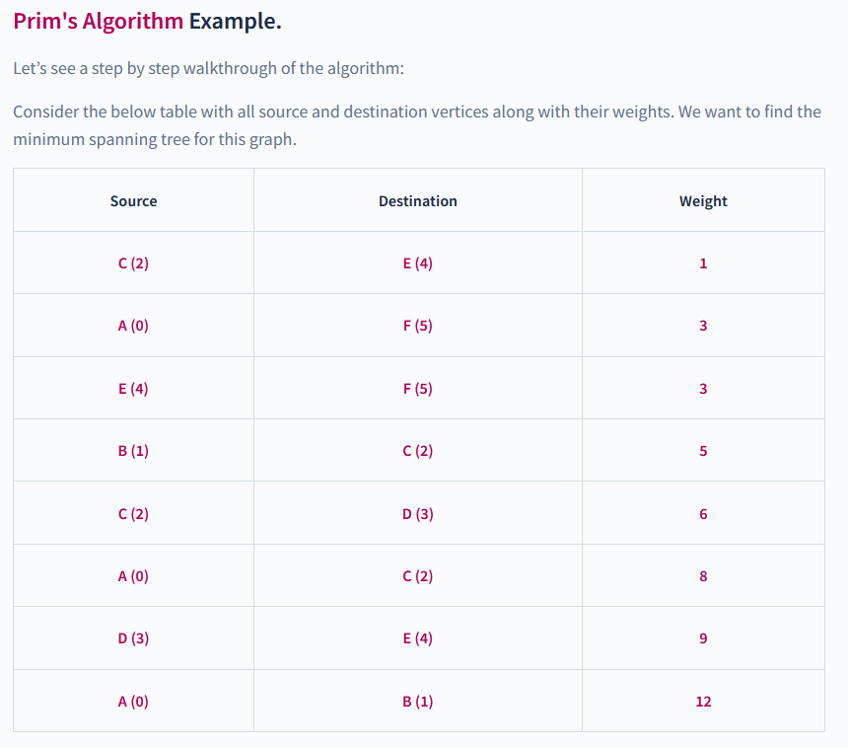
Prim’s Algorithm

Slide 31
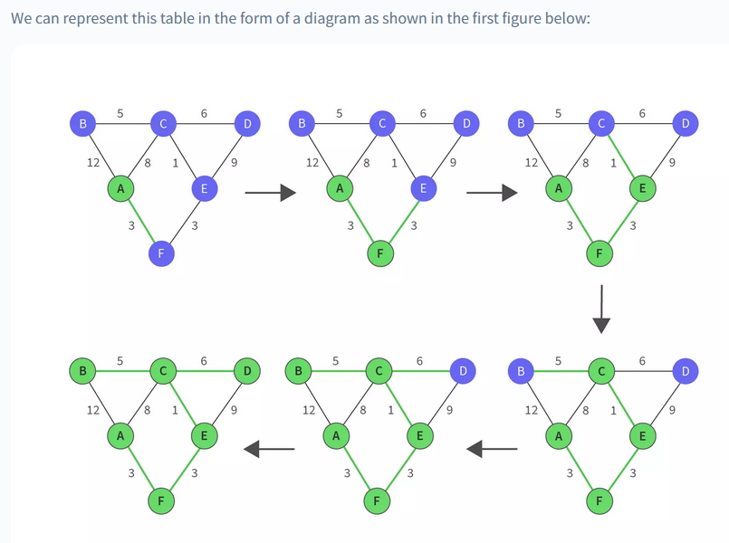
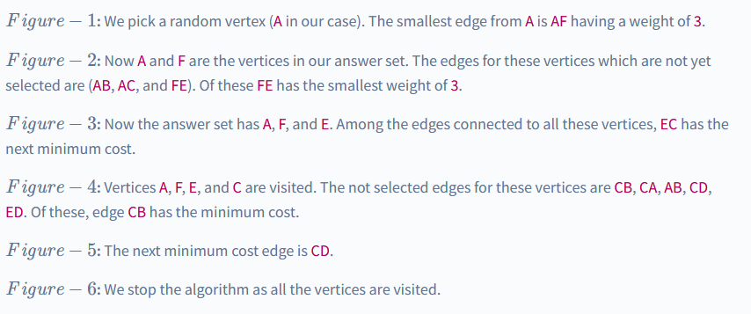

Slide 32
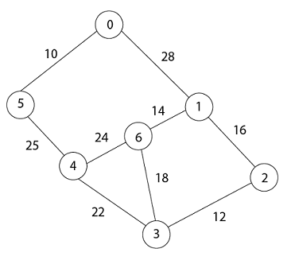
Prim’s Algo
In Prim's algorithm, first we initialize the priority Queue Q to contain all the vertices and the key of each vertex to ∞ except for the root, whose key is set to 0.
Suppose 0 vertex is the root, i.e., r. By EXTRACT - MIN (Q) procure, now u = r and Adj [u] = {5, 1}.

Slide 33
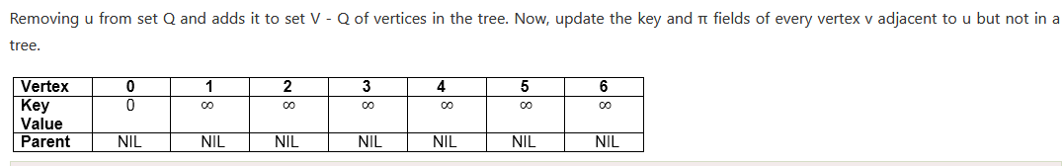
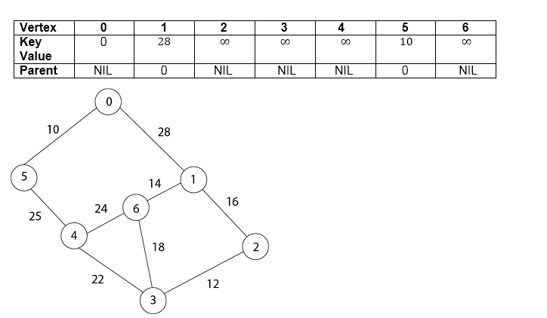

Slide 34


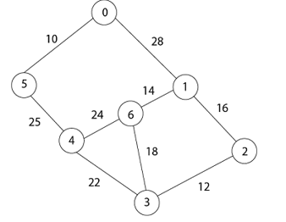
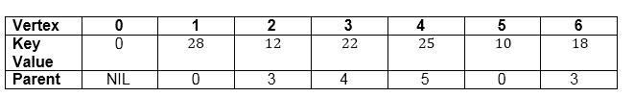
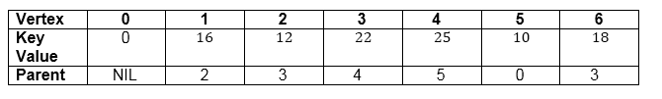


Slide 35
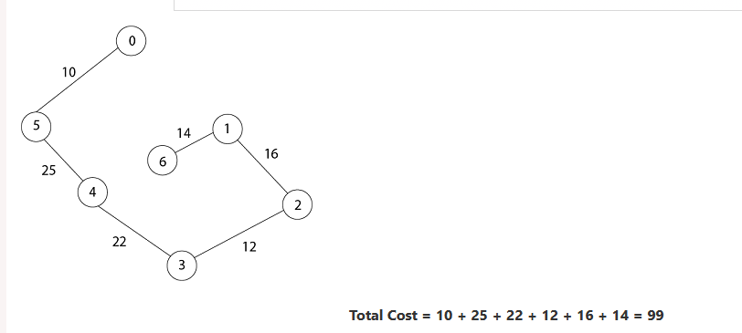
Final spanning Tree

Slide 36
Kruskal’s algorithm
Add smallest edge that connects two sets not already connected
1
A
C
E
3
4
5
4
4
2
MST
B
D
F
4
6
A
C
E
G
B
D
F

Slide 37
Kruskal’s algorithm
Add smallest edge that connects two sets not already connected
1
A
C
E
3
4
5
4
4
2
MST
B
D
F
4
6
1
A
C
E
G
B
D
F

Slide 38
Kruskal’s algorithm
Add smallest edge that connects two sets not already connected
1
A
C
E
3
4
5
4
4
2
MST
B
D
F
4
6
1
A
C
E
G
2
B
D
F

Slide 39
Kruskal’s algorithm
Add smallest edge that connects two sets not already connected
1
A
C
E
3
4
5
4
4
2
MST
B
D
F
4
6
1
A
C
E
G
4
2
B
D
F

Slide 40
Kruskal’s algorithm
Add smallest edge that connects two sets not already connected
1
A
C
E
3
4
4
4
2
5
MST
B
D
F
4
6
1
A
C
E
G
4
4
2
B
D
F

Slide 41
Kruskal’s algorithm
Add smallest edge that connects two sets not already connected
1
A
C
E
3
4
4
4
2
5
MST
B
D
F
4
6
1
A
C
E
G
4
4
2
5
B
D
F

Slide 42
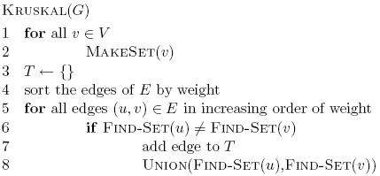
Running time of Kruskal’s
|V| calls to MakeSet

Slide 43
Running time of Kruskal’s
O(|E| log |E|)

Slide 44
Running time of Kruskal’s
2 |E| calls to FindSet

Slide 45
Running time of Kruskal’s
|V| calls to Union

Slide 46
Running time of Kruskal’s Algorithm
Disjoint set data structure
O(|E| log |E|) +
MakeSet
FindSet |E| calls
Union |V| calls
Total
Linked lists
|V|
O(|V| |E|)
|V|
O(|V||E| + |E| log |E|)
O(|V| |E|)
Linked lists + heuristics
|V|
O(|E| log |V|)
|V|
O(|E| log |V|+ |E| log |E|)
O(|E| log |E| )

Slide 47
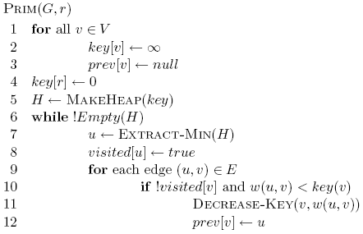
Prim’s algorithm

Slide 48
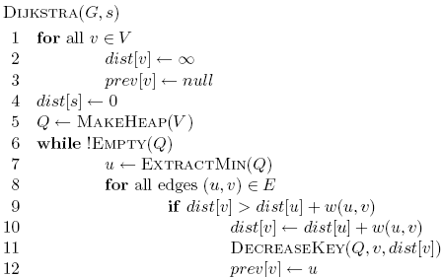
Prim’s algorithm

Slide 49
Prim’s algorithm

Slide 50
Prim’s algorithm
Start at some root node and build out the MST by adding the lowest weighted edge at the frontier

Slide 51
Prim’s
1
A
C
E
3
4
5
MST
4
4
2
B
D
F
4
6
A
C
E
B
D
F

Slide 52
Prim’s
1
A
C
E
3
4
5
MST
4
4
2
∞
∞
∞
B
D
F
4
6
A
C
E
B
D
F
∞
∞
0

Slide 53
Prim’s
1
A
C
E
3
4
5
MST
4
4
2
∞
4
5
B
D
F
4
6
A
C
E
B
D
F
∞
6
0

Slide 54
Prim’s
1
A
C
E
3
4
5
MST
4
4
2
∞
4
5
B
D
F
4
6
A
C
E
B
D
F
∞
6
0

Slide 55
Prim’s
1
A
C
E
3
4
5
MST
4
4
2
1
4
5
B
D
F
4
6
A
C
E
B
D
F
4
2
0

Slide 56
Prim’s
1
A
C
E
3
4
5
MST
4
4
2
1
4
5
B
D
F
4
6
A
C
E
B
D
F
4
2
0

Slide 57
Prim’s
1
A
C
E
3
4
5
MST
4
4
2
1
4
5
B
D
F
4
6
A
C
E
B
D
F
4
2
0

Slide 58
Prim’s
1
A
C
E
3
4
5
MST
4
4
2
1
4
5
B
D
F
4
6
A
C
E
B
D
F
4
2
0

Slide 59
Prim’s
1
A
C
E
3
4
5
MST
4
4
2
1
4
5
B
D
F
4
6
A
C
E
B
D
F
4
2
0

Slide 60
Prim’s
1
A
C
E
3
4
5
MST
4
4
2
1
4
5
B
D
F
4
6
A
C
E
B
D
F
4
2
0

Slide 61
Prim’s
1
A
C
E
3
4
5
MST
4
4
2
1
4
5
B
D
F
4
6
A
C
E
B
D
F
4
2
0

Slide 62
Prim’s
1
A
C
E
3
4
5
MST
4
4
2
1
4
5
B
D
F
4
6
A
C
E
B
D
F
4
2
0

Slide 63
Running time of Prim’s
Θ(|V|)

Slide 64
Running time of Prim’s
Θ(|V|)

Slide 65
Running time of Prim’s
|V| calls to Extract-Min

Slide 66
Running time of Prim’s
|E| calls to Decrease-Key

Slide 67
Running time of Prim’s
Same as Dijksta’s algorithm
1 MakeHeap
|V| ExtractMin
|E| DecreaseKey
Total
Array
O(|V|)
O(|V|²)
O(|E|)
O(|V|²)
Bin heap
O(|V|)
O(|V| log |V|)
O(|E| log |V|)
O((|V|+|E|) log |V|)
O(|E| log |V|)
Fib heap
O(|V|)
O(|V| log |V|)
O(|E|)
O(|V| log |V| + |E|)
Kruskal’s: O(|E| log |E| )

